Slide 1

Day-time patterns of food, energy and nutrient intake: results from the NDNS Rolling Programme 2008-2016
Luigi Palla
Chrononutrition: from epidemiology to molecular mechanism
London 13/11/2018

Slide 2

Chrononutrition and meal timing
Circadian rhythm known to be regulating physiological responses but impact on nutrition still unclear (Almoosawi et al, 2018)
Recent evidence indicated specific meal times associated with health outcomes
(Uemera et al, 2015; Almoosawi et al, 2016;…)
Extensive study of quantity/quality of food and nutrient intake by dietary patterns, i.e. by statistical methods that account jointly for consumption of several foods or nutrients
Meal timing investigation at its dawn. It requires a multivariate approach, i.e. account for different eating times in the day.

Slide 3
Chrononutrition and NDNS data
First hurdle is represented by the need (for collection) of suitable data that record the timing of food consumption.
National Diet and Nutrition Survey 2008-2016 present an opportunity:
Collects 3 or 4 day diet diaries from about 1000 people yearly;
Representative sample of the British population;
Records information on the time of eating for each food item.

Slide 4
NDNS study design
Participants were asked to record food and drinks consumed both at home and away from home.
Participants were therefore asked to take the diary with them when away from home.
Interviewers undertook three visits with each participant:
place the diary.
visit to check for compliance, answer questions or deal with problems and review the diary to identify and edit possible omissions and missing detail.
collect the diary and again review and edit possible omissions. No later than three days after the last diary day.

Slide 5

Collecting the evidence on time of … Eating
NDNS classification of eating time
Food intake is already classified as falling in 7 conventional time-slots:
6-9am (breakfast)
9-12 (mid morning)
12-2pm (lunch)
2-5pm (afternoon)
5-8pm (dinner)
8-10pm (late evening)
10pm-6am (night)

Slide 6
Chrononutrition and NDNS
Challenges at the level of Data description/pattern recognition (data reduction)
Timing of food intake may vary depending on
Time classification (temporal intervals)
Use of nutrients or foods:
If nutrients are used, which ones are to be included?
If foods are used, which classification, eg foods vs food groups
Which statistical methods may help describe/summarise temporal eating patterns in a synthetic and interpretable way?

Slide 7
Chrononutrition and NDNS
Challenges at the level of testing hypotheses on relationship between eating time patterns and health outcomes (statistical/causal inference)
Incorporating the dimensionally reduced exposure in the outcome model
General issues with Observational Data →
Methods to adjust for confounding (multivariable regression models, propensity scores methods)
Unmeasured confounding
Missing Data
Cross sectional data → what is direction of causality?

Slide 8
Multivariate methods for Data Dimensionality Reduction
CATEGORICAL VARIABLES:
Correspondence Analysis
Latent Class Analysis
CONTINUOUS VARIABLES:
Principal Component Analysis
CONTINUOUS OR CATEGORICAL (not both):
Cluster Analysis

Slide 9
Chrononutrition projects
Adolescents from 2008-2012 NDNS data:
Timing of food consumption
Timing of energy intake
Adults from 2008-2016 NDSN data:
Timing of energy intake
Timing of carbo-hydrate intake

Slide 10
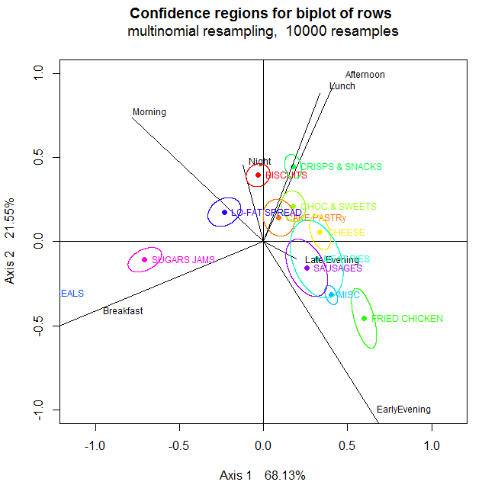
Timing of food consumption in adolescents (2008-2012)
Correspondence Analysis (CA) biplots
Sugary jams with breakfast;
low-fat spreads with morning;
chocolate/sweets and cake/pastries with
afternoon;
sausage and meat pies with both early and
late evening;
biscuits with night.
Logistic regression
Odds of consuming biscuits at night was 67% higher compared with the rest of the day (OR=1.67, 95% CI=1.14:2.44,p=0.008);
Odds ratios were estimated with adjustment for the effect of sex, age and weekend/weekday.
L Palla, AN Chapman, JD Johnston, S Almoosawi (2017) - Proceedings of the Nutrition Society, 76 (OCE4)

Slide 11
Timing of energy and food intake in adolescents (2008-2012)
Principal Component Analysis of average energy intake within hour of the day.
Average across 3 or 4 day diaries per person;
24 hourly rather than 7 time slots.
Components are linear combination of the 24 original variables
First 3 components (out of 24), explaining 20% of the total variability (plot)
Plot shows the loadings of the original variables
Interpretation
Odds of
Joint work with Suzana Almoosawi

Slide 12
Timing of Energy Intake in Adults (2008-2016)
Men Women
Adults Wider dataset (8 years)
Latent Class Analysis Based on binary variable (is there an eating occasion with more than 50 calories within the hourly interval?)
Eating occasion defined within 15 minutes interval (as per Leech et al, 201 )
Collapsing the night time hours.
3 classes emerge: early eaters, late eaters, grazers
All
R.Mansukhani, L Palla (2018 - Proceedings of the Nutrition Society, 77 (OCE1)

Slide 13
Timing of Carbohydrate intake in Adults (2008-2016)
Need to consider also macronutrients across the whole day;
BUT additional complexity given by:
Taking into account multiple nutrients and need to choose the relevant ones.
When using Latent Class Analysis (probabilistic method), need to decide which cut-offs for the consumption of nutrients are suitable.
Decide how to synthesize the data since these are collected across a few days , eg average might determine loss of information

Slide 14
Timing of Carbohydrate intake in Adults (2008-2016)
Data description and choices made for statistical modelling:
-24483 days observed on 6155 adults (2537 men and 3618 women)
-we opted to study Carbo-hydrate intake as nutrient mostly related nutrient to diabetes.
-7 time slots as in NDNS classification
Categorization of CH consumption across time slots:
no energy intake;
CH contributed < 50% of total energy intake in that time slot,
CH contributed>50% of total energy intake in that time slot.
-Multilevel latent class analysis (MLCA) accounting for the repeated measurement of intake over 3-4 days nested within individuals.

Slide 15
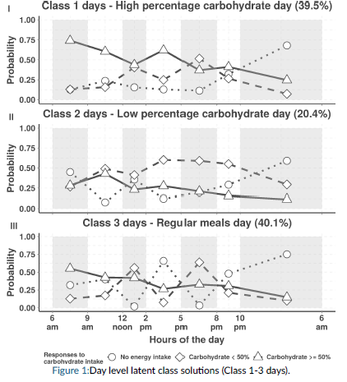
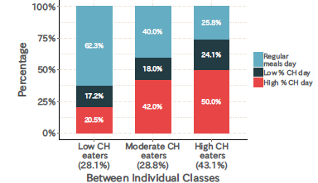
Timing of Carbohydrate intake in Adults (2008-2016)
C.Wang, S.Almoosawi, L.Palla (2018) Unpublished manuscript (cft poster)

Slide 16
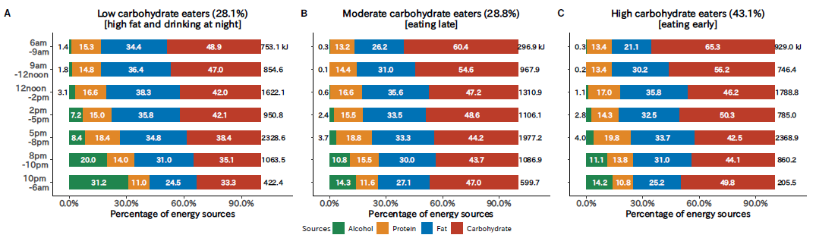
Timing of Carbohydrate intake in Adults (2008-2016)
C.Wang, S.Almoosawi, L.Palla (2018) Unpublished manuscript (cft poster)

Slide 17
Discussion

Slide 18
Summary and conclusions
NDNS provide valuable data for chrononutrition
Need for application of dimensionality reduction techniques to extract the circadian eating patterns
Different techniques may be applied according to the specific research question (food/food groups vs nutrient/multiple nutrients) and way the variables are measured (categorical/continuous, cut-offs chosen, eating occasions/time intervals, repeated measures).
Different techniques may be able to highlight different patterns/features in the data.
Often the more complexity taken into account → more involved interpretation
Biases in epidemiological studies/underreporting may have different impact on different techniques – worth investigating these on simulation but hard to judge on application to real data.

Slide 19
Acknowledgements
Suzana Almoosawi (Northumbria University)
Chaochen Wang (Aichi Medical University, Japan)
Raoul Mansukhani (LSHTM)
Andrew Chapman

Slide 20
References

